Slide 1


JavaScript Syntax and Operators
JS Syntax and JS Operators
SoftUni Team
Technical Trainers
Software University
http://softuni.bg

Slide 2
Have a Question?
sli.do
#JSCORE

Slide 3
Table of Content
JavaScript Syntax
Values
Literals
Variables
Operators
Syntactic Categories
JavaScript Operators
Comparison Operators
Logical Operators
Type Operators

Slide 4
JavaScript Syntax
Values, Literals, Variables, Operators, Expressions

Slide 5

JavaScript Syntax
JavaScript syntax refers to a set of rules that determine how the language will be written (by the programmer) and interpreted (by the browser).
let x, y; // Declare variables
x=5; y=6; // Assign values
let z = x + y; // Calculate values
console.log(z); // Print values

Slide 6
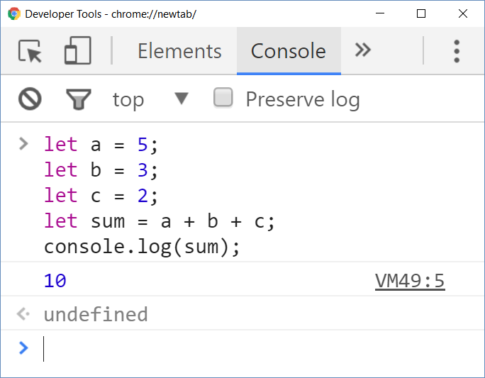
JavaScript Code: Example
let a = 5;
let b = 3;
let c = 2;
let sum = a + b + c;
console.log(sum);

Slide 7
JavaScript Fixed Values
Fixed values – literals
Array Literals: list of zero or more array element, enclosed in square brackets ([ ])
Square brackets
Array element
let cars = ["Ford", "BMW", "Peugeot"]
let arrayLength = cars.length; // 3
let secondCar = cars[1]; // "BMW"

Slide 8
JavaScript Fixed Values (2)
Boolean Literals: two literal values – true and false
console.log("0" == true); // false
console.log("0" == false); // true
if ("0") {console.log(true)}; // true
console.log([] == true); // false
console.log([] == false); // true
if ([]) {console.log(true)}; // true
console.log(null == false || null == true); // false
if (!null) {console.log(true)}; // true

Slide 9
JavaScript Fixed Values (2)
Integers:
Floating-points Literal can have the following parts: preceded by "+" or "-"; a decimal point ("."); a fraction (another decimal number); an exponent.
0, 16, -528 // Decimal, base10
015, 0001, -0o77 // Octal, base8
0x1123, 0x00111, -0xF1A7 // Hexadecimal, "hex" or base16
0b11, 0b0011, -0b11 // Binary, base2
3.141854, -0.54875, -3.1E+12, .1e-23

Slide 10
JavaScript Fixed Values (3)
Object Literals: list of zero or more pairs of property names
and associated values of an object, enclosed in curly braces { }
let car = {type: "Infiniti", model: "QX80", color: "blue"};
let carType = car.type;
let carType = car.["type"]; // Access property
car.year = 2018;
car["year"] = 2018; // Add new property
car.color = "black";
car["color"] = "black"; // Correct existing property

Slide 11
JavaScript Fixed Values (4)
RegExp Literals: pattern enclosed between slashes (/ /)
String Literals: immutable sequences of Unicode characters
let pattern = /[A-Za-z]+/;
"hello", "apple", '123', 'I like my car'
let str = "Infiniti QX80";
console.log(str.length); // 13
console.log(str[0]); // I
str[0] = 's'; // Beware: no error, but str stays unchanged!
console.log(str); // "Infiniti QX80" console.log(str[20]); // undefined
JavaScript special characters: \b, \n, \t, \v,\', \", \\

Slide 12
Problem: String Length
You are given three strings argument
Print the sum of strings length and average length round down
function solve(arr1, arr2, arr3) {
let sumLength;
let averageLength;
let firstArgLength = arr1.length;
let secondArgLength = arr2.length;
let thirdArgLength = arr3.length;
sumLength = firstArgLength + secondArgLength + thirdArgLength;
averageLength = Math.floor(sumLength/3);
}

Slide 13
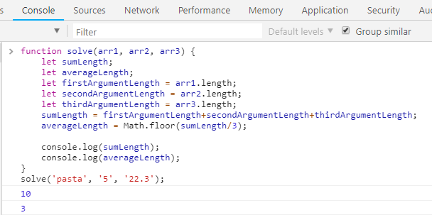
Problem: String length (2)
function solve(arr1, arr2, arr3){
console.log(sumLength);
console.log(averageLength);
}
solve('pasta', '5', '22.3')
Check your solution here: https://judge.softuni.bg/Contests/Practice/Index/1421#0

Slide 14
JavaScript Variable Values
Variable values – variables are used to store data values
JS uses let, const and var keywords to declare variables:
let – for reassign a variable:
const - once assigned, constants cannot be modified:
var - a keyword which defines a variable globally regardless of
block scope. Do not use var in your code.
let name = "George";
name = "Maria";
const name = "George";
name = "Maria";
console.log(name) // TypeError: Assignment to constant variable.

Slide 15
JavaScript Operators
Arithmetic operators: they take numerical values (either literals or variables) as their operands and returns a single numerical value
Addition (+)
Subtraction (-)
Multiplication (*)
Division (/)
Remainder (%)
Exponentiation (**)
let a = 15;
let b = 5;
let c;
c = a + b; // 20
c = a - b; // 10
c = a * b; // 75
c = a / b; // 3
c = a % b; // 0
c = a ** b; // 759375

Slide 16
Arithmetic Оperators
console.log(3 + 4 - 2); // 5 (add / subtract numbers)
console.log(5 / 0); // Infinity (divide by zero)
console.log(Infinity / Infinity); // NaN (wrong division)
console.log(Math.round(7 / 3)); // 2 (integral division)
console.log(Math.ceil(7 / 3)); // 3 (integral division)
console.log(Math.floor(7 / 3)); // 2 (integral division)
console.log(7 % 3); // 1 (remainder of division)
console.log(5.3 % 3); // 2.3 (remainder of division)
let a = 5; console.log(++a); // 6 (prefixed ++)
console.log(a++); // 6 (postfix ++)

Slide 17
JavaScript Operators
Assignment operators: they assign a value to its left operand based in the value of its right operand.
let a = 15;
let b = 5;
a = b; // Assign the value of b to a
console.log(a); // 5
console.log(b); // 5
let a = 15;
let b = 5;
b = a; // Assign the value of a to b
console.log(a); // 15
console.log(b); // 15

Slide 18
Compound assignment operators
Name | Shorthand operator | Meaning
Assignment | x = y | x = y
Addition assignment | x += y | x = x + y
Subtraction assignment | x -= y | x = x - y
Multiplication assignment | x *= y | x = x * y
Division assignment | x /= y | x = x / y
Remainder assignment | x %= y | x = x % y
Exponentiation assignment | x **= y | x = x ** y

Slide 19
JavaScript Syntactic Categories
In JavaScript there are two major syntactic categories:
Statements are "commands" to be executed
if
else if
let number = 5;
if (number % 2 === 0) {
console.log("Even number");
}
let number = 5;
if (number % 2 === 0) {
console.log("Even number");
} else {
console.log("Odd number");
}

Slide 20
Statements
for (let i = 0; i <= 5; i++){
console.log(i) ; // 0 1 2 3 4 5
};
for
switch
let day = 3;
switch (day) {
case 1: console.log('Monday'); break;
case 2: console.log('Tuesday'); break;
case 3: console.log('Wednesday'); break;
…
case 7: console.log('Sunday'); break;
default: console.log('Error!'); break;
};

Slide 21
Problem: Math Operators
Make the required arithmetic operation between two numbers and an arithmetic operator you take from the input
function solve(num1, num2, operator) {
let result;
switch (operator) {
case '+': result = num1 + num2; break;
case '-': result = num1 - num2; break;
case '*': result = num1 * num2; break;
case '/': result = num1 / num2; break;
case '%': result = num1 % num2; break;
case '**': result = num1 ** num2; break;
}
console.log(result);
}
solve(5, 6, '+');
Check your solution here: https://judge.softuni.bg/Contests/Practice/Index/1421#1

Slide 22
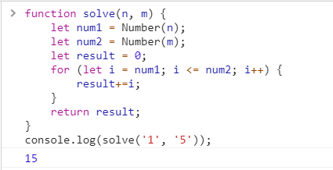
Problem: Sum of Numbers N...M
Calculate the sum of all numbers from n to m
function solve(n, m) {
let result = 0;
let num1 = Number(n);
let num2 = Number(m);
for (let i = num1; i <= num2; i++) {
result+=i;
}
return result;
}
solve(1, 5);
Check your solution here: https://judge.softuni.bg/Contests/Practice/Index/1421#2

Slide 23
Statements (1)
while
do-while
let count = 1;
while (count < 1024) {
console.log(count *= 2); // 2 4 8 16 32 64 128 256 512 1024
};
let s = "ho";
do {
console.log(s); // ho hoho hohohoho hohohohohohohoho
s = s + s;
};
while (s.length < 20);

Slide 24
Statements (2)
for … in loop
for … of loop
let nums = [5, 10, 15, 20, 'maria', true];
for (let index in nums){
console.log(index);
};
// 0 1 2 3 4 5 → loops through the indices (keys), not values
let nums = [5, 10, 15, 20, 'maria', true];
for (let value of nums){
console.log(value);
};
// 5 10 15 20 maria true → loops through the values

Slide 25
Statements (3)
debugger
variable declaration
let x = 15 * 5; debugger; console.log(x);
// With the debugger turned on,
this code should stop executing
before it executes the third line
let x = 5; // x stores the value 5
let y = 14.5; // y stored the value 14.5

Slide 26
Expressions
Expression is any valid unit of code that resolves to a value:
with side effects:
with resolve effects:
let assignedVariable = 2; // This is a statement
assignedVariable = 5; // expression
console.log(assignedVariable) // 5
let assignedVariable = 2; // This is a statement
assignedVariable + 4; // expression
assignedVariable * 10; // expression
assignedVariable – 10; // expression
console.log(assignedVariable); // 2

Slide 27
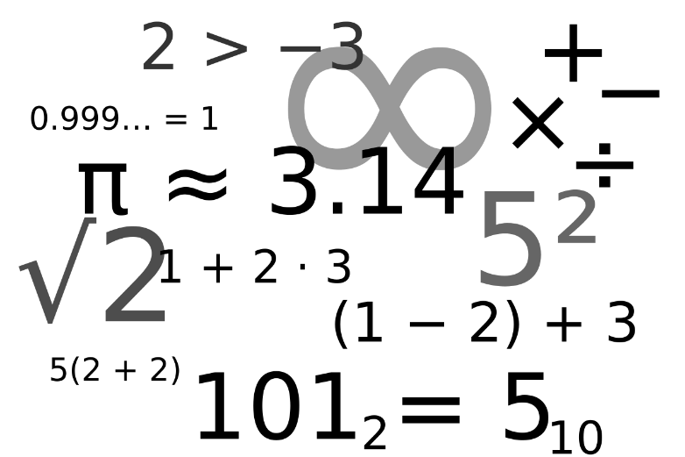
JavaScript Operators
Comparison, Logical Operators

Slide 28
Comparison Operators
Comparison operators - compare values
The == means "equal after type conversion"
The === means "equal and of the same type"
The != means "not equal after type conversion"
The !== means "not equal and of the same type"
The > means "greater than"
The < means "less than"
The >= means "greater than or equal to"

Slide 29
Comparison Operators (2)
The <= means "less than or equal to“
The ? is ternary operator
let a = 5;
let b = 4;
console.log(a == b); // false
console.log(0 === ""); // false
console.log(a != b); // true
console.log(3 !== "3"); // true
console.log(a < "5.5"); // true
console.log(a >= b); // true
console.log(0 == []); // true
console.log(a ? b : 10); // 4

Slide 30
Logical Operators
Logical operators are used to determine the logic between variables or values
&& (logical and) - returns the leftmost "false" value:
|| (logical or) - operators returns the leftmost "true" value:
let val = true && 'yes' && 5 && null && false;
console.log(val); // null
let val = true && 'no' && 5 && 25 && 'yes';
console.log(val); // 'yes'
If all values are true, return the last value
If all values are false, return the last value
let val = false || 0 || '' || 5 || 'hi' || true;
console.log(val); // 5
let val = false || '' || null || NaN || undefined;
console.log(val); // undefined

Slide 31
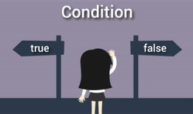
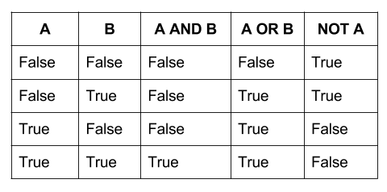
Logical Operators (2)
! (logical not) – convert the operand to Boolean type: true/false
let val = !true
console.log(val); // false
let val = !false;
console.log(val); // true

Slide 32
Problem: Larger Number
Write a JS function that takes three number arguments as input and find the largest of them.
function solve(num1, num2, num3) {
let result;
if(num1>num2 && num1>num3) {
result = num1;
} else if (num2>num1 && num2>num3) {
result = num2;
} else if(num3>num1 && num3>num2) {
result = num3;
}
console.log(`The largest number is ${result}.`)
}
solve(5, -3, 16)
Check your solution here: https://judge.softuni.bg/Contests/Practice/Index/1421#3

Slide 33
Typeof Operator
The typeof operator returns a string indicating the type of operand
let val = 5; console.log(typeof(val)); // number
let str = 'hello'; console.log(typeof(str)); // string
let obj = {name: 'Maria', age:18};
console.log(typeof(obj)); // object
let arr = [1, 2, 3]; console.log(typeof(arr)); // object
let bool = true; console.log(typeof(bool)); // Boolean
let func = function(){};
console.log(typeof(func)); // function
let date = new Date();
console.log(typeof(date)); // object
console.log(typeof(notDeclaredVariable)); //undefined

Slide 34
Problem: Circle Area
Calculate the circle area if the input is a number. You need to check the type of the input
function solve(input) {
let result = 0;
let inputType = typeof(input);
if (inputType === 'number') {
result = Math.pow(input, 2) * Math.PI;
console.log(result.toFixed(2));
} else {
console.log(`We can not calculate the circle area, because we receive a ${inputType}.`)
}
}
solve(5);
Check your solution here: https://judge.softuni.bg/Contests/Practice/Index/1421#4

Slide 35
Instanceof Operator
The instanceof operator returns true if the specified object in an instance of the specified object:
let cars = ["Saab", "Volvo", "BMW"]; console.log(cars instanceof Array); // Returns true console.log(cars instanceof Object); // Returns true console.log(cars instanceof String); // Returns false console.log(cars instanceof Number); // Returns false

Slide 36

Live Exercises in Class (Lab)
Practice: JavaScript Syntax and Operators

Slide 37

Summary
Basic JavaScript syntax
Conditional statements in JS are like in all modern programming languages:
Classical conditionals: if-else, switch-case
Loops in JavaScript
Classical loops: while, do-while, for loops
Iterate over collection: for … in and for … of
Comparison operators - ==, ===, >, <, >=, <=, !=, !==, ?
Logical operators - &&, ||, !
Typeof, instanceof
…
…
…

Slide 38
https://softuni.bg/trainings/2247/js-fundamentals-january-2019

Slide 39













SoftUni Diamond Partners

Slide 40





SoftUni Organizational Partners

Slide 41




Trainings @ Software University (SoftUni)
Software University – High-Quality Education and Employment Opportunities
softuni.bg
Software University Foundation
http://softuni.foundation/
Software University @ Facebook
facebook.com/SoftwareUniversity
Software University Forums
forum.softuni.bg

Slide 42

License
This course (slides, examples, demos, videos, homework, etc.) is licensed under the "Creative Commons Attribution-NonCommercial-ShareAlike 4.0 International" license

